Slide 1
String Manipulation
Notes:
https://www.excel-easy.com/vba/create-a-macro.html

Slide 2
Table of Contents
JOIN STRINGS
Left extraction
right extraction
mid extraction
GET Length FROM string
Substrings
Separate strings
String reversal

Slide 3
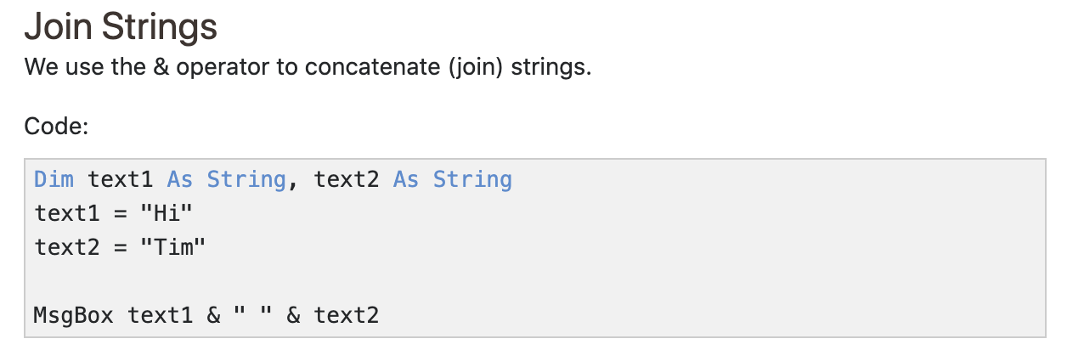
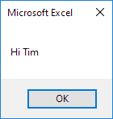
JOIN STRINGS
Result:
Note: to insert a space, use " "

Slide 4
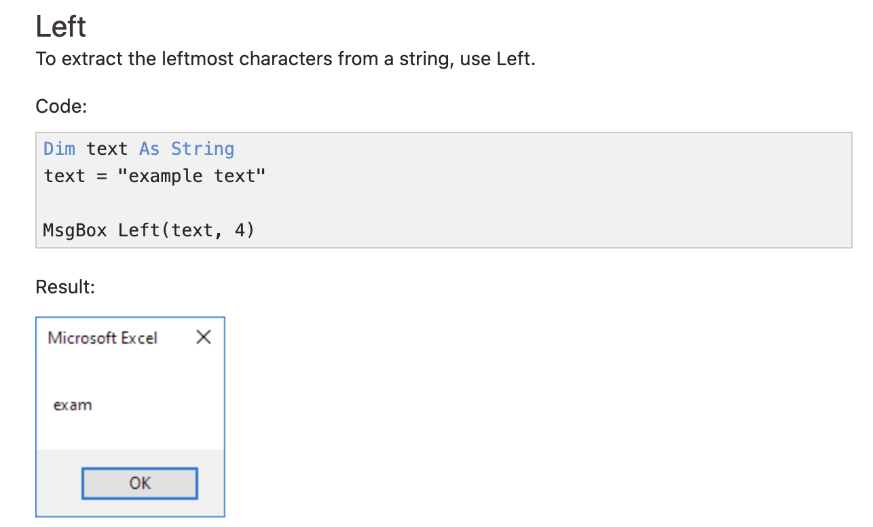
Left extraction

Slide 5
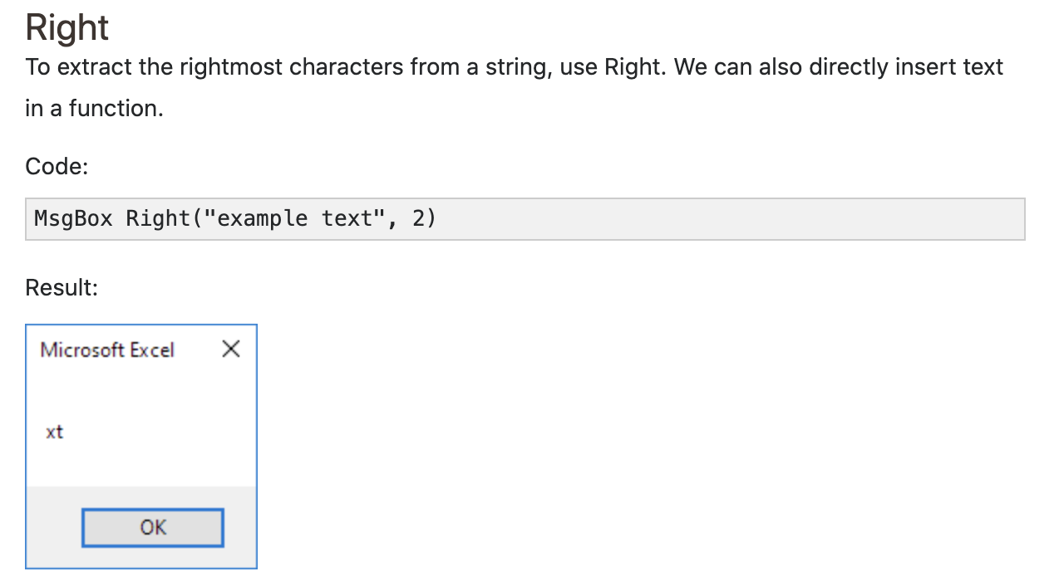
right extraction

Slide 6
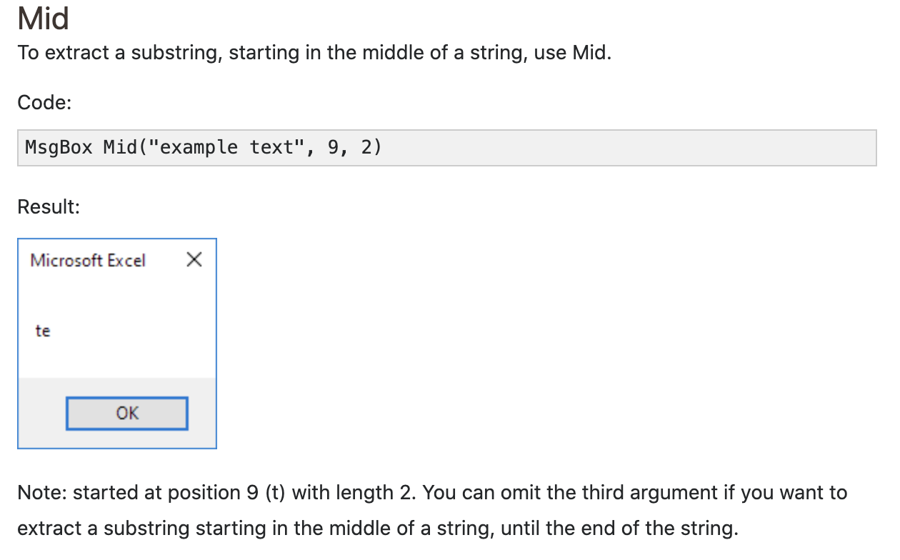
mid extraction

Slide 7
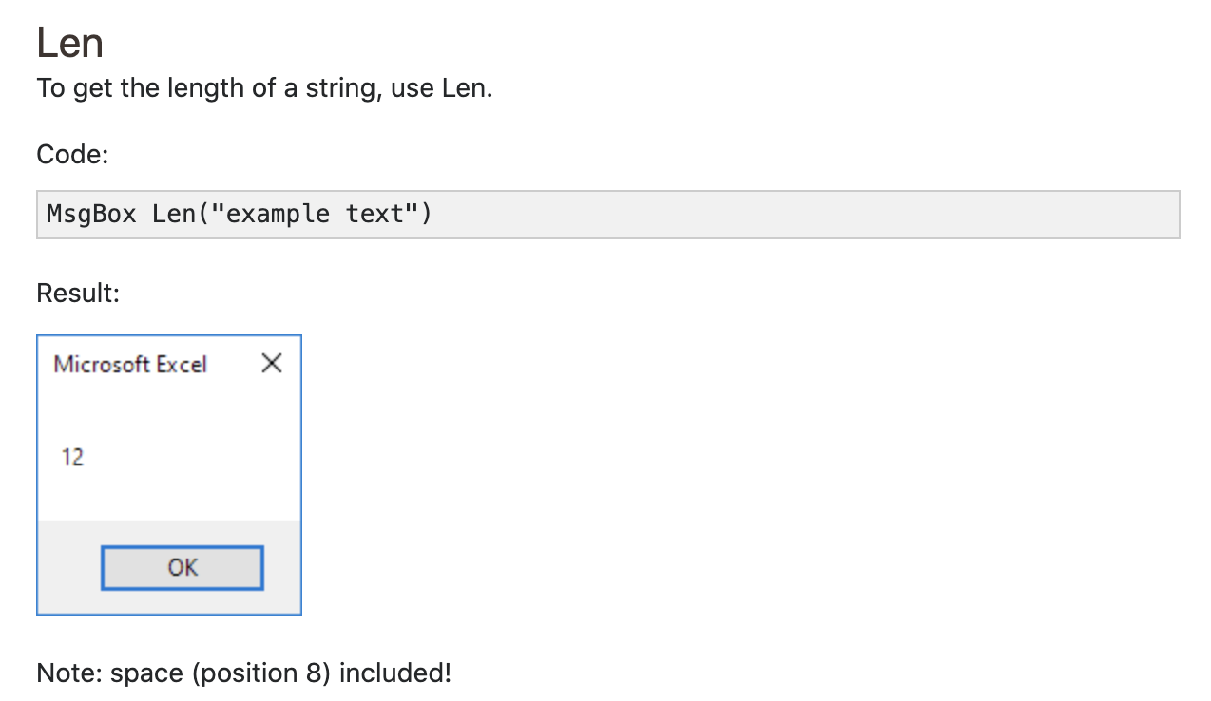
GET Length FROM string

Slide 8
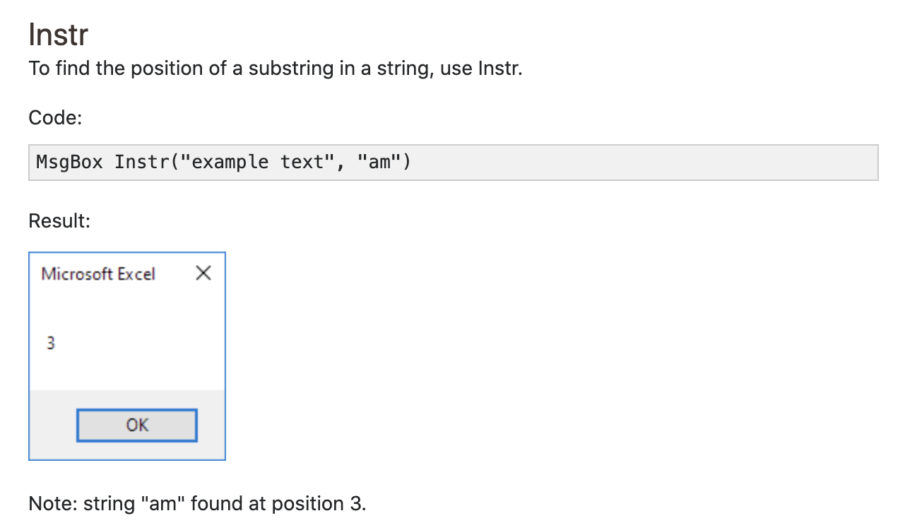
Substrings

Slide 9
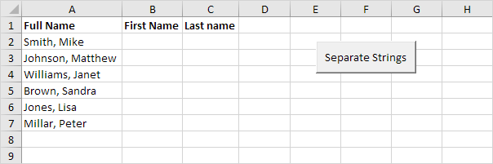
Separate strings
Below we will look at a program in Excel VBA that separates strings.

Slide 10
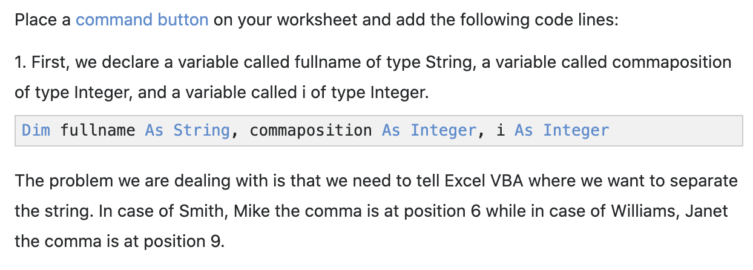
Separate strings

Slide 11
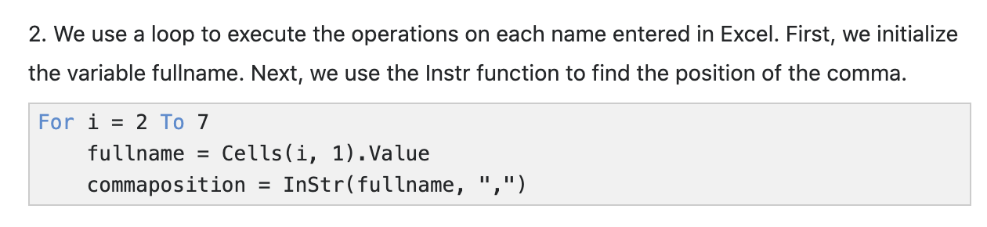
Separate strings

Slide 12
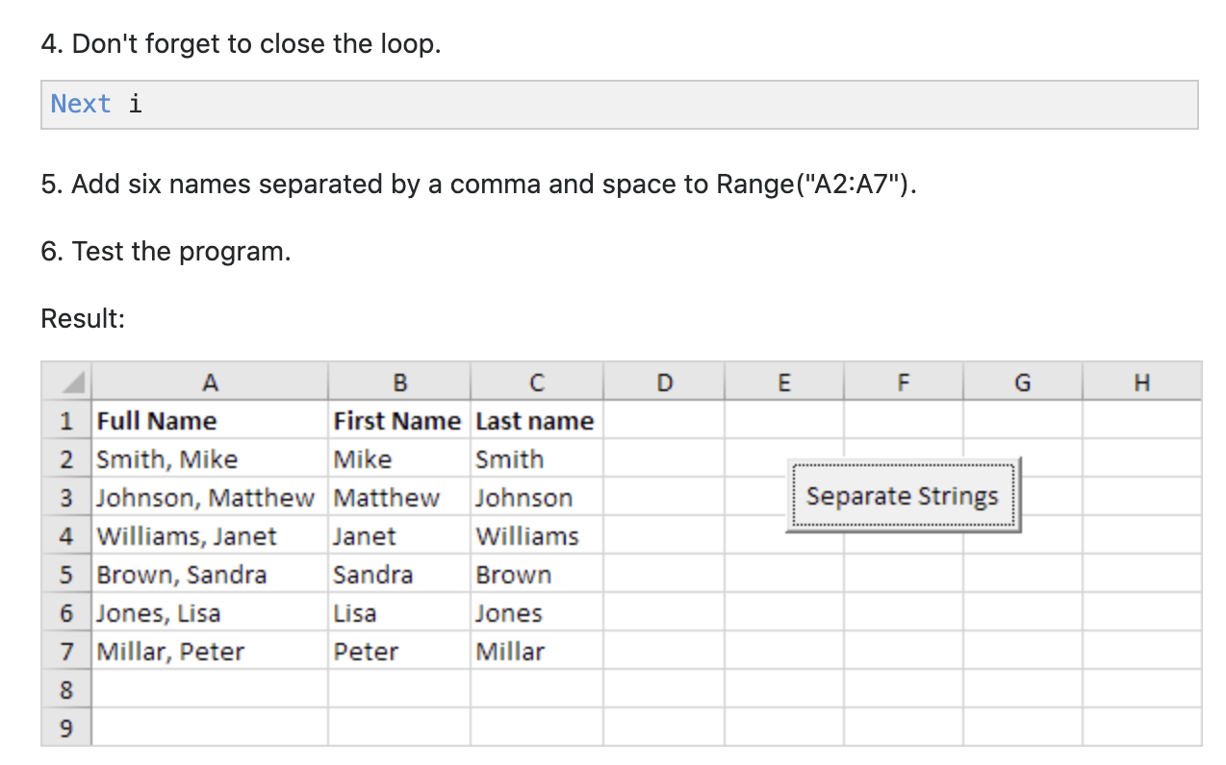
Separate strings

Slide 13
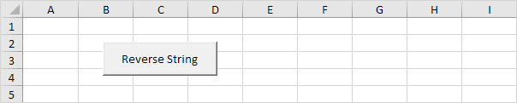
String reversal
Below we will look at a program in Excel VBA that can reverse strings.

Slide 14
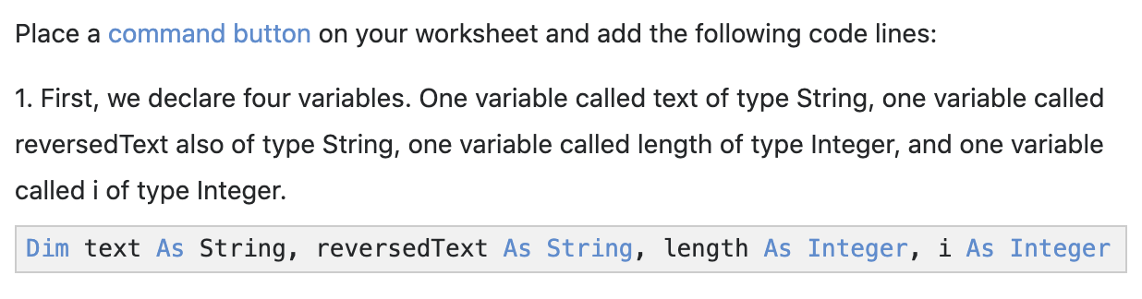
String reversal

Slide 15
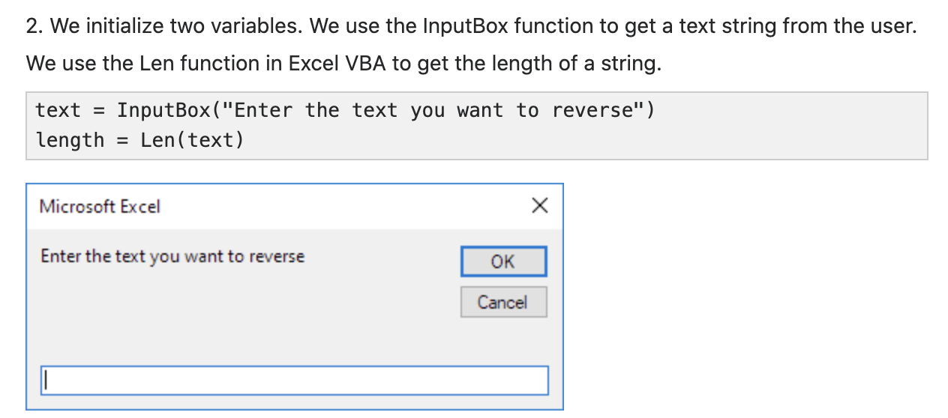
String reversal

Slide 16
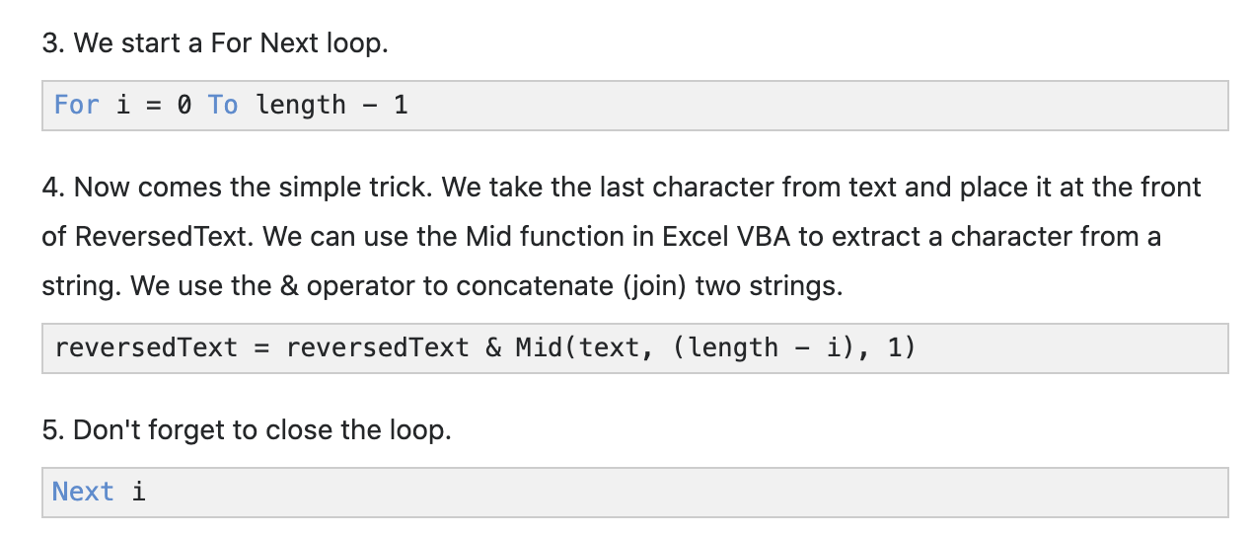
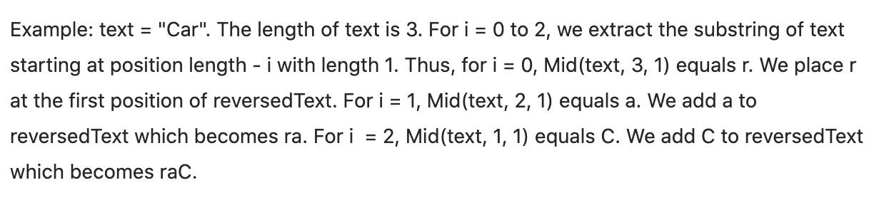
String reversal

Slide 17
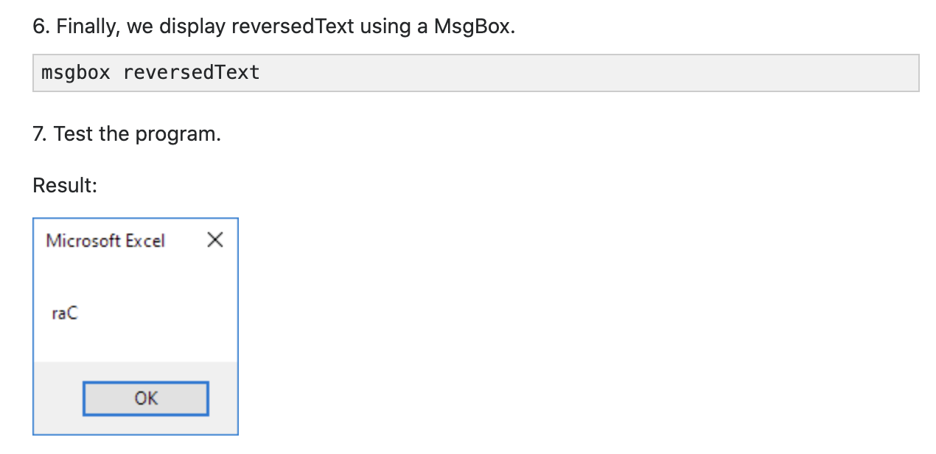
String reversal

